Slide 1
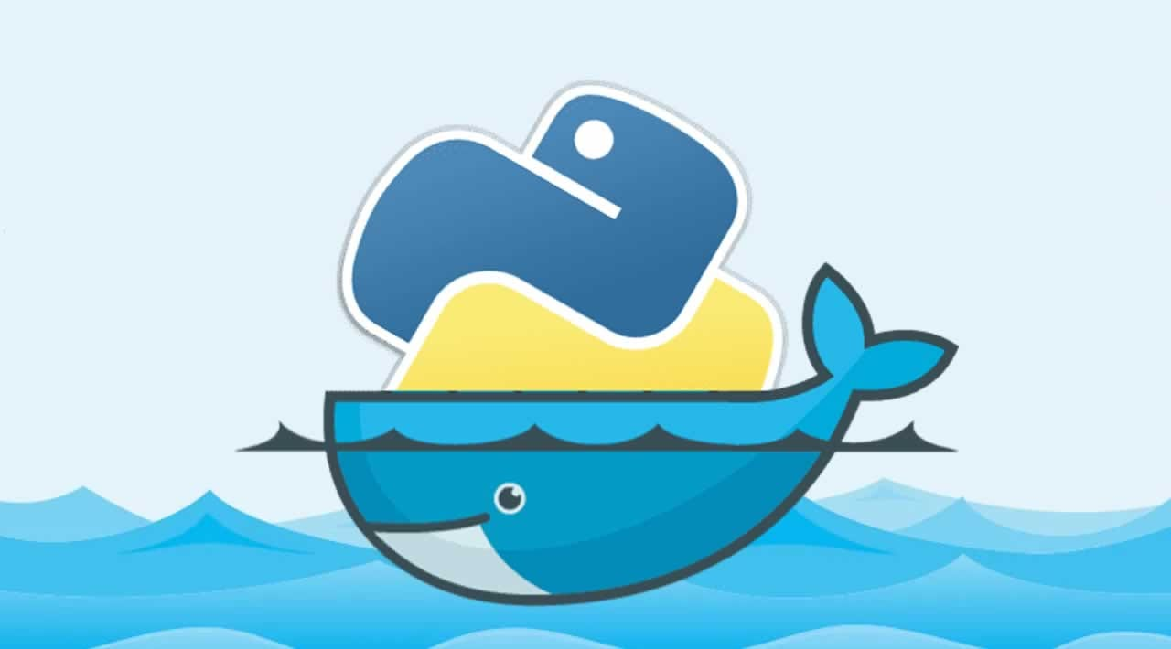
Python & Containers

Slide 2
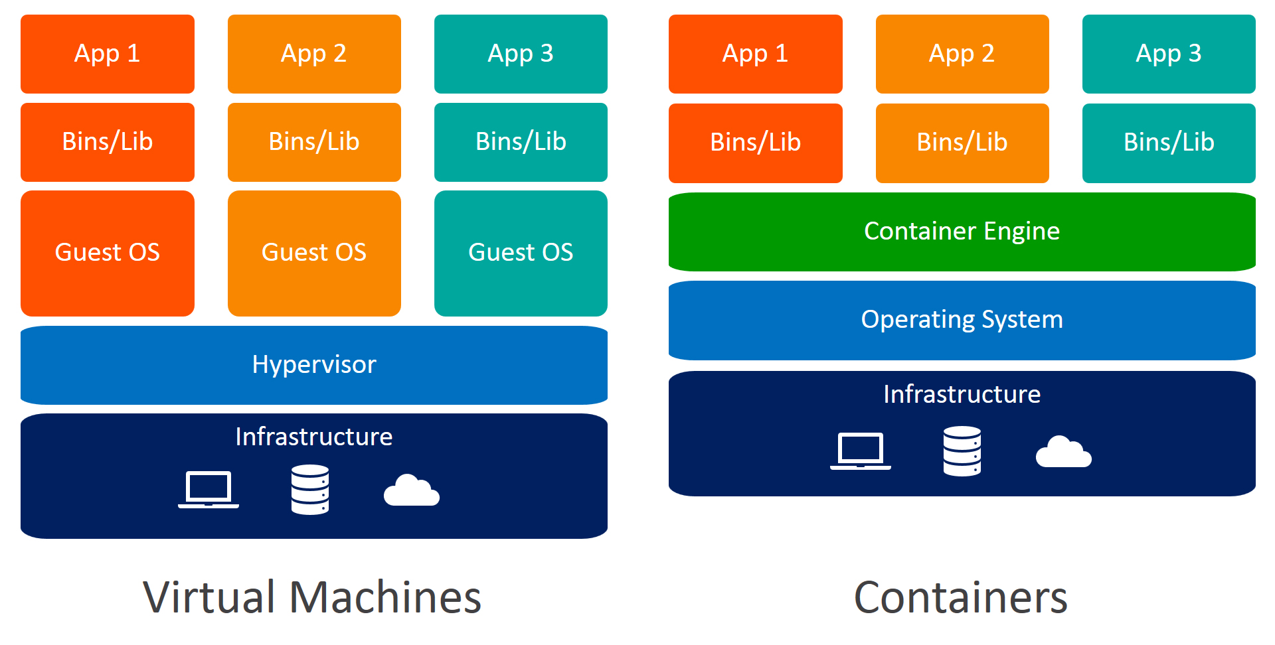
VMs vs Containers

Slide 3
Container uses
Container images are essentially a snapshot in time on a system, allowing you to:
Lock dependency versions.
Simplify running of your software + dependencies.
Package your code for distribution or deployment.

Slide 4






Semantics
Docker popularised containers, but is only a tool using the Open Container Initiatives.
There are alternatives: podman, buildah, skopeo.
`Docker` images are actually `container` images.

Slide 5
Docker Desktop
If you use Windows, and are not comfortable using Linux, then Docker Desktop may be the easiest way to run containers.
It essentially emulates a Linux environment (or uses underlying Windows Subsystem for Linux).
I won’t go into how to best install Docker, Podman, or any other tools. Contact me afterwards if issues.

Slide 6
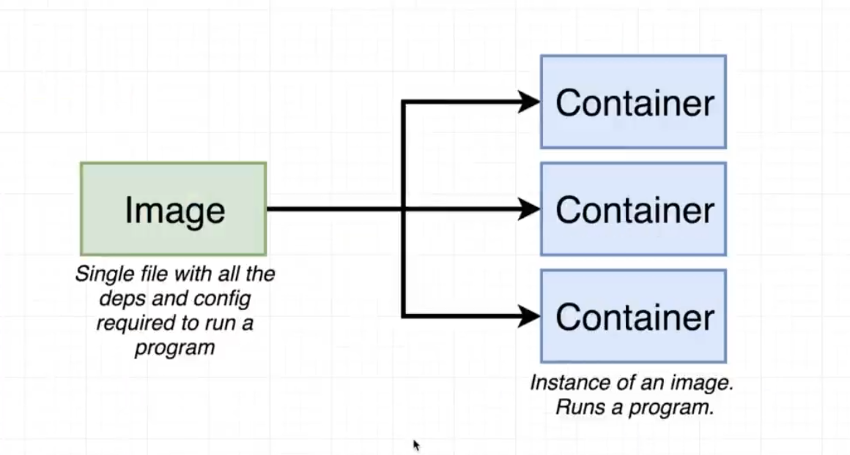
Image vs Container
Images are the snapshot of the system, created from a set of build instructions (i.e. your install procedure).
Containers are spawned from images and are the running version of your application.

Slide 7
Demo
Container image builds
Running containers
https://gitlabext.wsl.ch/EnviDat/docker-demo

